Slide 1
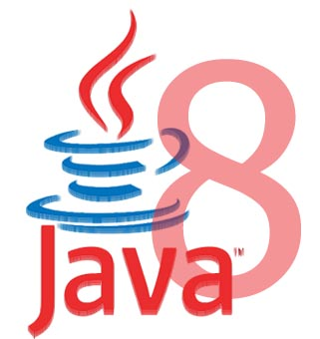
Java 8 - Features

Slide 2
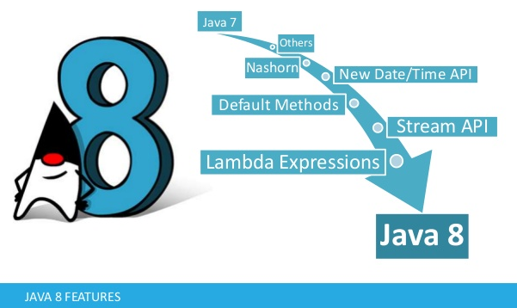
Introduction to Java 8
Java 8 was released in early 2014.
In java 8, most talked about feature was lambda expressions.
It has many other important features as well such as default methods, stream API and new date/time API.

Slide 3

New Features of Java 8
New Features in Java language
Lambda Expression
Functional Interface
Interface’s default and Static Methods
Method References
New Features in Java libraries
Stream API
Date/Time API
Nashorn, JavaScript Engine − A Java-based engine to execute JavaScript code.

Slide 4
Lambda Expressions
In programming, a Lambda expression (or function) is just an anonymous function.
i.e., a function with no name and without being bounded to an identifier.
They are written exactly in the place where it’s needed, typically as a parameter to some other function.
Unnamed block of code (or an unnamed function) with a list of formal parameters and a body.
Lambda expression facilitates functional programming, and simplifies the development a lot.
Its helpful in Collections, to iterate, filter & extract data.
Notes:
Lambda expressions are not unknown to many of us who have worked on advanced languages like Scala.

Slide 5
The basic syntax of a lambda expression
(parameters) -> expression
or
(parameters) -> { statements; }
or
() -> expression
Optional type declaration
Optional parenthesis around parameter
Optional curly braces
Optional return keyword
Arrow
(Person p1, Person p2) -> p1.getAge().compareTo(p2.getAge());
Lambda parameters
Lambda body

Slide 6
Lambda - Examples
(int a, int b) -> a * b // takes two integers and returns their multiplication
(a, b) -> a - b // takes two numbers and returns their difference
() -> 99 // takes no values and returns 99
(String a) -> System.out.println(a) // takes a string, prints its value to the console, and returns nothing
a -> 2 * a // takes a number and returns the result of doubling it
c -> { //some complex statements } // takes a collection and do some processing

Slide 7
Rules for writing lambda expressions
A lambda expression can have zero, one or more parameters.
The type of the parameters can be explicitly declared or it can be inferred from the context.
Multiple parameters are enclosed in mandatory parentheses and separated by commas.
Empty parentheses are used to represent an empty set of parameters.
When there is a single parameter, if its type is inferred, it is not mandatory to use parentheses. e.g. a -> return a*a.

Slide 8
Rules for writing lambda expressions
The body of the lambda expressions can contain zero, one or more statements.
If body of lambda expression has single statement curly brackets are not mandatory and the return type of the anonymous function is the same as that of the body expression.
When there is more than one statement in body than these must be enclosed in curly brackets.

Slide 9
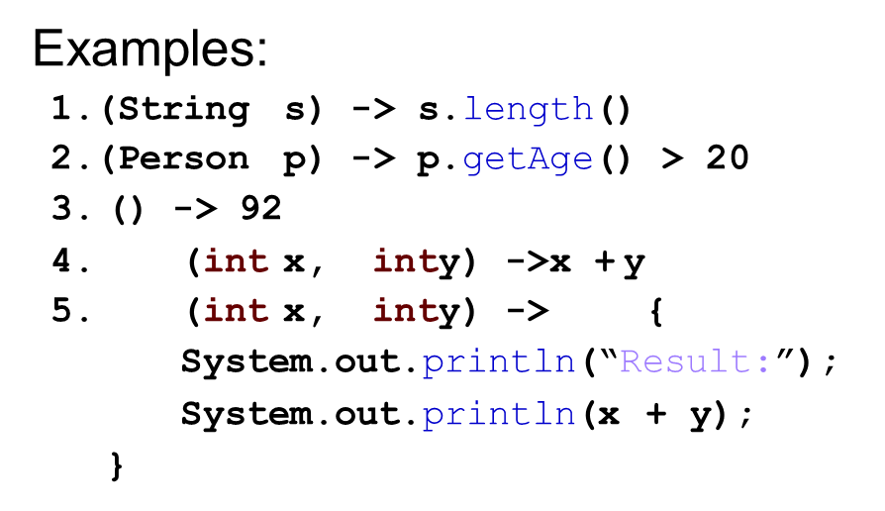
Lambda Expressions

Slide 10
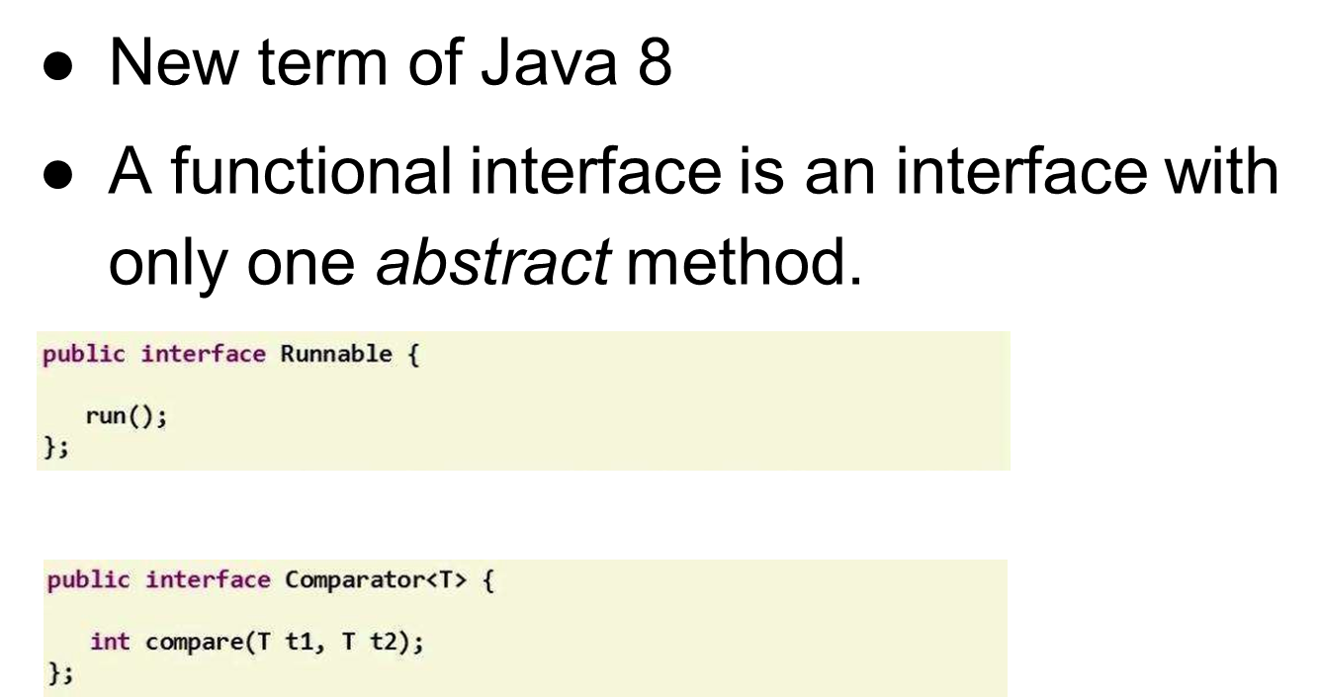
What is a Functional interface?

Slide 11
Functional Interface
Single Abstract Method interfaces (SAM Interfaces) is not a new concept.
It means interfaces with only one single method.
In java, we already have many examples of such SAM interfaces.
From java 8, they will also be referred as functional interfaces as well.
For example, a Comparable interface with a single method ‘compareTo’ is used for comparison purpose.
Java 8 has defined a lot of functional interfaces to be used extensively in lambda expressions.

Slide 12
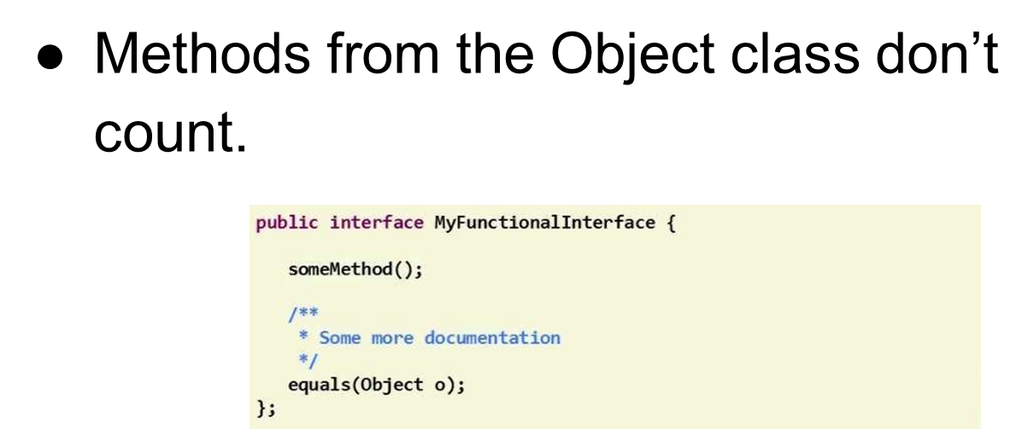
Functional Interface

Slide 13
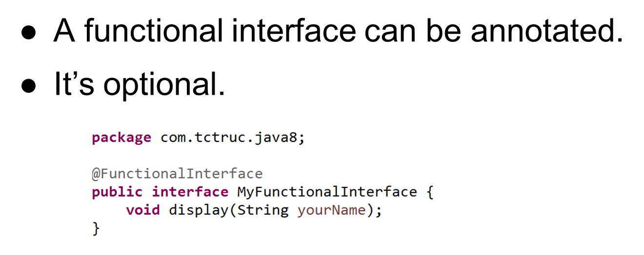
Annotation in Functional Interface

Slide 14
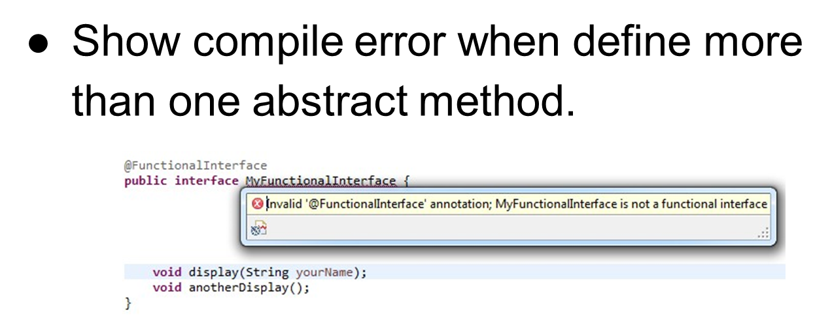
Functional Interface

Slide 15
Lambda vs Functional Interface
We know that Lambda expressions are anonymous functions with no name and they are passed (mostly) to other functions as parameters.
In java method parameters always have a type and this type information is looked for to determine which method needs to be called in case of method overloading or even simple method calling.
So, basically every lambda expression also must be convertible to some type to be accepted as method parameters.
Well, that type in which lambda expressions are converted, are always of functional interface type.

Slide 16
Where should we use Lambda?
If we have to write a thread which will print “howtodoinjava” in console then simplest code will be:
new Thread(new Runnable() {
@Override
public void run() { System.out.println("howtodoinjava");
}
}).start();
If we use the lambda expression for this task then code will be :
new Thread(
() -> {
System.out.println("My Runnable");
}
).start();
Notes:
We have also see that Runnable is an functional interface with single method run(). So, when you pass lambda expression to constructor of Thread class, compiler tries to convert the expression into equivalent Runnable code as shown in first code sample. If compiler succeed then everything runs fine, if compiler is not able to convert the expression into equivalent implementation code, it will complain. Here, in above example, lambda expression is converted to type Runnable.

Slide 17
Lambda vs FI
In simple words, a lambda expression is an instance of a functional interface.
But a lambda expression itself does not contain the information about which functional interface it is implementing;
That information is deduced from the context in which it is used.

Slide 18
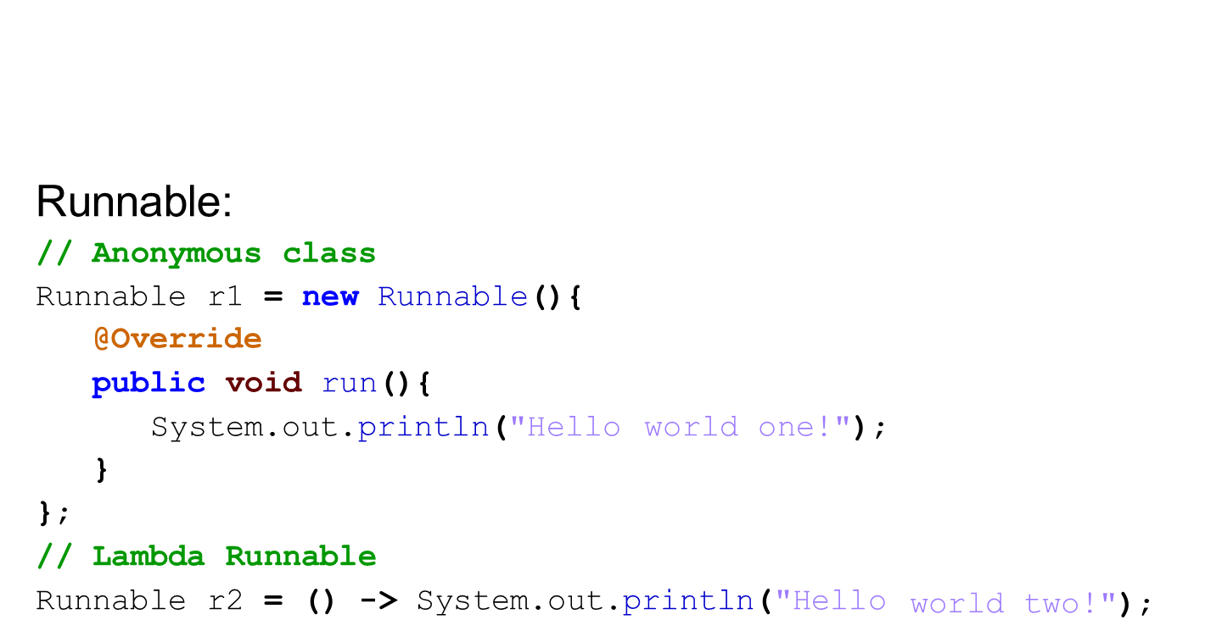

Slide 19
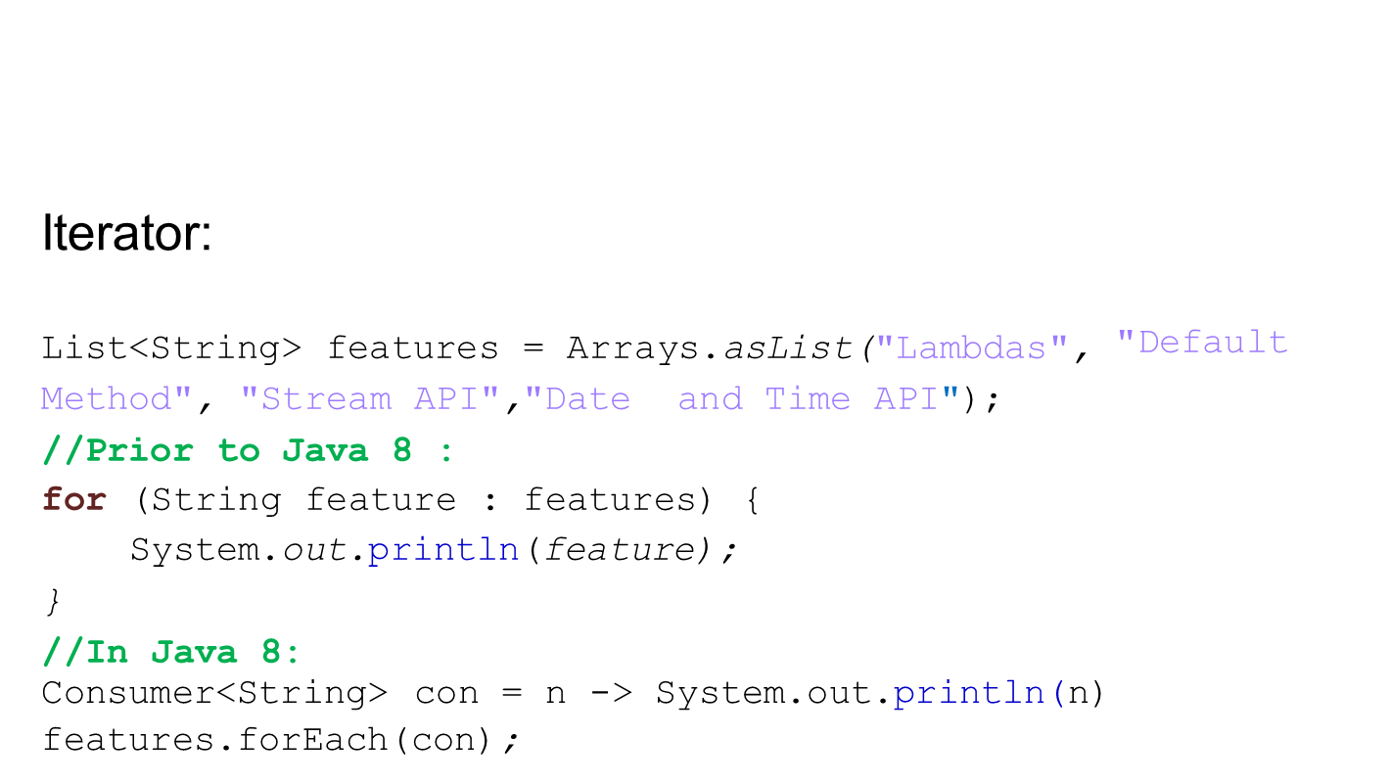

Slide 20
Why Lambda Expressions ?
Enable to treat functionality as a method argument, or code as data.
A function that can be created without belonging to any class.
A lambda expression can be passed around as if it was an object and executed on demand.

Slide 21
Java 8 Method Reference
In Java, we can use references to objects, either by creating new objects or by using existing objects.
List list = new ArrayList();
List list2 = list;
If we only use a method of an object in another method, we still have to pass the full object as an argument.
Wouldn't it be more practical to just pass the method as an argument.
isFull(list.size);

Slide 22
Java 8 Method Reference Operator - ::
In Java 8, thanks to lambda expressions, we can use methods as if they were objects, or primitive values.
A method reference is the shorthand syntax for a lambda expression that executes just ONE method.
Here's the general syntax of a method reference:
Object :: methodName
In a method reference, you place the object (or class) that contains the method before the :: operator and the name of the method after it without arguments.
Consumer<String> c = System.out::println;

Slide 23
Method Reference
So to use a method reference, you first need a lambda expression with one method.
And to use a lambda expression, you first need a functional interface, an interface with just one abstract method.
list.forEach(System.out::println);

Slide 24
Method References
There are four kinds of method references:
Reference to a static method
Reference to an instance method of a particular object
Reference to an instance method of an arbitrary object of a particular type
Reference to a constructor

Slide 25
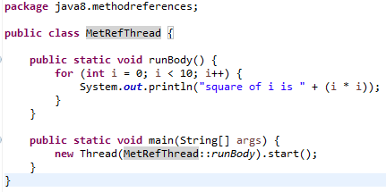
Method References
Reference to a static method
The syntax: ContainingClass::staticMethodName

Slide 26
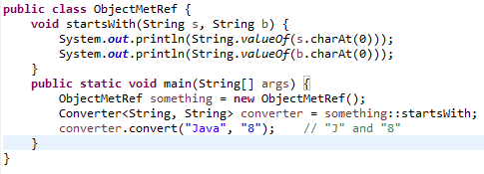
Method References
Reference to an instance method of a particular object The syntax: containingObject::instanceMethodName

Slide 27
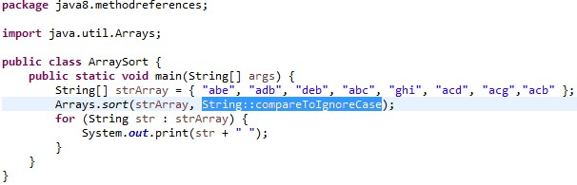
Method References
Reference to an instance method of an arbitrary object of a
particular type
The syntax: ContainingType::methodName

Slide 28
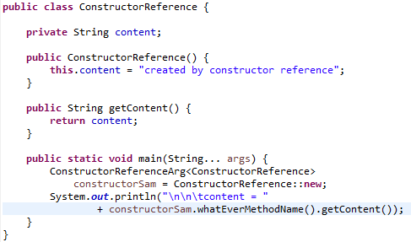

Method References
Reference to a constructor
The syntax: ClassName::new

Slide 29
Method References
Method references as Lambdas Expressions
Syntax | Example | As Lambda
ClassName::new | String::new | () -> new String()
Class::staticMethodName | String::valueOf | (s) -> String.valueOf(s)
object::instanceMethodName | x::toString | () -> "hello".toString()
Class::instanceMethodName | String::toString | (s) -> s.toString()

Slide 30
Java Predicate Interface
It is a functional interface which represents a predicate (boolean-valued function) of one argument.
It is defined in the java.util.function package.
It contains test() a functional method.
It improves manageability of code, helps in unit-testing them separately

Slide 31
Java Predicate Interface Methods
Methods | Description
boolean test(T t) | It evaluates this predicate on the given argument.
default Predicate<T> and(Predicate<? super T> other) | It returns a composed predicate that represents a short-circuiting logical AND of this predicate and another. When evaluating the composed predicate, if this predicate is false, then the other predicate is not evaluated.
default Predicate<T> negate() | It returns a predicate that represents the logical negation of this predicate.
default Predicate<T> or(Predicate<? super T> other) | It returns a composed predicate that represents a short-circuiting logical OR of this predicate and another. When evaluating the composed predicate, if this predicate is true, then the other predicate is not evaluated.
static <T> Predicate<T> isEqual(Object targetRef) | It returns a predicate that tests if two arguments are equal according to Objects.equals(Object, Object).

Slide 32
Java Predicate Interface Example
import java.util.function.Predicate;
public class PredicateInterfaceExample {
public static void main(String[] args) {
Predicate<Integer> pr = a -> (a > 18); // Creating predicate
System.out.println(pr.test(10)); // Calling Predicate method
}
}

Slide 33
Java 8 - Default Methods
Java provides a facility to create default methods inside the interface.
Java 8 allows you to add non-abstract methods in interfaces.
These methods must be declared default methods.
Default methods were introduces in java 8 to enable the functionality of lambda expression.
Methods which are defined inside the interface and tagged with default are known as default methods.

Slide 34
Default Methods
These methods are non-abstract methods.
This capability is added for backward compatibility so that old interfaces can be used to leverage the lambda expression capability of Java 8.
Default methods enable you to add new functionality to the interfaces of your libraries and ensure binary compatibility with code written for older versions of those interfaces.

Slide 35
Default Methods - Example
public interface Moveable {
default void move(){
System.out.println("I am moving");
}
}
Moveable interface defines a method move() and provided a default implementation as well.
If any class implements this interface then it need not to implement it’s own version of move() method. It can directly call instance.move()

Slide 36
Default Methods - Example
public class Animal implements Moveable{
public static void main(String[] args){
Animal tiger = new Animal();
tiger.move();
}
}
If class willingly wants to customize the behavior of move() method then it can provide it’s own custom implementation and override the method.

Slide 37
Static Methods
The interfaces can have static methods as well which is similar to static method of classes.

Slide 38

Java 8 – Streams API
A Stream in Java can be defined as a sequence of elements from a source that supports aggregate operations on them.
The source here refers to a Collections or Arrays who provides data to a Stream.
Stream keeps the ordering of the data as it is in the source.
The aggregate operations or bulk operations are operations which allow us to express common manipulations on stream elements easily and clearly.

Slide 39
Java 8 – Streams API
Java provides a new additional package in Java 8 called java.util.stream.
Another major change introduced Java 8 is Streams API.
It provides a mechanism for processing a set of data in various ways.
It include filtering, transformation, or any other way that may be useful to an application.
Streams API in Java 8 supports a different type of iteration.
Stream does not store elements.
It defines methods for the set of items to be processed, the operation(s) to be performed on each item, and where the output of those operations is to be stored.

Slide 40
Java Stream vs. Collection
A Collection is an in-memory data structure, which holds all the values that the data structure currently has—every element in the Collection has to be computed before it can be added to the Collection.
A Stream is a conceptually fixed data structure, in which elements are computed on demand.
This gives rise to significant programming benefits.
The idea is that a user will extract only the values they require from a Stream, and these elements are only produced—invisibly to the user—as and when required.

Slide 41
Characteristics of Stream
Not a data structure
Designed for lambdas
Do not support indexed access
Can easily be outputted as arrays or lists
Lazy access supported
Parallelizable

Slide 42
Lazy Access
Lazy Class Loading
JRE has built-in lazy initialisation of classes.
Classes load into memory only when they are first referenced.
It reduces memory usage
Lazy Object Creation
Objects are created at run time whenever it is required.

Slide 43
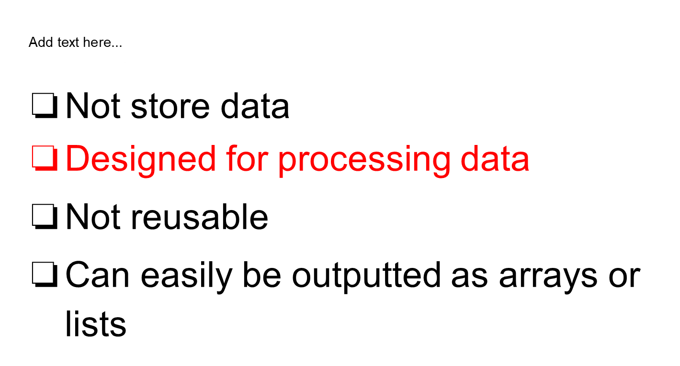

Slide 44
S^{Add t}t^{ext}r^{he}e^{re...}am - How to use
Build a stream
Transform stream
Collect result

Slide 45
S^{Add t}t^{ext}r^{he}e^{re...}am - build streams
Build streams from collections
List<Dish> dishes = new ArrayList<Dish>();
....(add some Dishes)....
Stream<Dish> stream = dishes.stream();
stream() − Returns a sequential stream considering collection as its source.

Slide 46
S^{Add t}t^{ext}r^{he}e^{re...}am - build streams
Build streams from arrays
Integer[] integers =
{1, 2, 3, 4, 5, 6, 7, 8, 9};
Stream<Integer> stream = Stream.of(integers);

Slide 47
Different Operations On Streams
Intermediate Operations
Each intermediate operation is lazily executed and returns a stream as a result.
Hence various intermediate operations can be pipelined.
Terminal Operations
Terminal operations mark the end of the stream and return the result.

Slide 48
Stream Methods -Intermediate Operations
map: The map method is used to map the items in the collection to other objects according to the Predicate passed as argument. List number = Arrays.asList(2,3,4,5); List square = number.stream().map(x->x*x).collect(Collectors.toList());
filter: The filter method is used to select elements as per the Predicate passed as argument. List names = Arrays.asList("Reflection","Collection","Stream"); List result = names.stream().filter(s->s.startsWith("S")).collect(Collectors.toList());
sorted: The sorted method is used to sort the stream. List names = Arrays.asList("Reflection","Collection","Stream"); List result = names.stream().sorted().collect(Collectors.toList());

Slide 49
Stream Methods - Terminal Operations
collect: The collect method is used to return the result of the intermediate operations performed on the stream. List number = Arrays.asList(2,3,4,5,3); Set square = number.stream().map(x->x*x).collect(Collectors.toSet());
forEach: The forEach method is used to iterate through every element of the stream. List number = Arrays.asList(2,3,4,5); number.stream().map(x->x*x).forEach(y->System.out.println(y));
reduce: The reduce method is used to reduce the elements of a stream to a single value. The reduce method takes a BinaryOperator as a parameter.
List number = Arrays.asList(2,3,4,5); int even = number.stream().filter(x->x%2==0).reduce(0,(ans,i)-> ans+i);

Slide 50
Java 8 – Date & Time API
Java 8 introduces a new date-time API under the package java.time.
It simply change the way we have been handling dates in java applications.
Important classes introduced in java.time package
Local − Simplified date-time API with no complexity of timezone handling.
Zoned − Specialized date-time API to deal with various timezones.

Slide 51
Date & Time API
Date class has even become obsolete. The new classes intended to replace Date class are :
The LocalDate class represents a date. There is no representation of a time or time-zone.
The LocalTime class represents a time. There is no representation of a date or time-zone.
The LocalDateTime class represents a date-time. There is no representation of a time-zone.

Slide 52
Date & Time Example
LocalDate localDate = LocalDate.now();
LocalTime localTime = LocalTime.of(12, 20);
LocalDateTime localDateTime = LocalDateTime.now();
OffsetDateTime offsetDateTime = OffsetDateTime.now();
ZonedDateTime zonedDateTime = ZonedDateTime.now(ZoneId.of("Europe/Paris"));
For date functionality with Zone information, Timezone offset can be represented

Slide 54
Java 8 - Optional Class
Java introduced a new class Optional in jdk8.
Optional is a container object used to contain not-null objects.
It is a public final class and used to deal with NullPointerException in Java application.
You must import java.util package to use this class.
It provides methods which are used to check the presence of value for particular variable.
It avoids any runtime NullPointerExceptions and supports us in developing clean and neat Java APIs or Applications.

Slide 55
Advantages of Java 8 Optional
Null checks are not required.
No more NullPointerException at run-time.
We can develop clean and neat APIs.
No more Boiler plate code
Notes:
A boilerplate is any form of writing that can be or is reused multiple times with minimal changes to the original content. This term is currently used in many fields, often to refer to standard written media such as warnings, product manuals, disclaimers, copyright statements and even end-user license agreements. In IT, this term refers to boilerplate code, which is code that has proved to efficient and can be extended to many applications. Code to produce standard mathematical operations, template programs, and most notably, open-source codes may all be considered boilerplate code.

Slide 56
Optional Class Methods
Optional.ofNullable() method returns a Non-empty Optional if a value present in the given object. Otherwise returns empty Optional.
Optionaal.empty() method is useful to create an empty Optional object.
Optional.filter() If a value is present and the value matches a given predicate, it returns an Optional describing the value, otherwise returns an empty Optional.
Optional.isPresent() returns true if the given Optional object is non-empty. Otherwise it returns false.
Optional.ifPresent() performs given action if the given Optional object is non-empty. Otherwise it returns false.
Optional.orElse() returns the value if present in Optional Container. Otherwise returns given default value.

Slide 57
Java 8 - Nashorn JavaScript
With Java 8, Nashorn, a much improved javascript engine is introduced, to replace the existing Rhino.
Nashorn is a JavaScript engine developed in the Java language.
Nashorn provides 2 to 10 times better performance, as it directly compiles the code in memory and passes the bytecode to JVM.
Nashorn uses invoke dynamics feature, introduced in Java 7 to improve performance.
A command line tool (jjs) for running javascript without using Java is also provided .

Slide 58
Calling JavaScript from Java
Using ScriptEngineManager, JavaScript code can be called and interpreted in Java.
It is implemented by importing following packages,constructors:
import javax.script.ScriptEngineManager;
import javax.script.ScriptEngine;
import javax.script.Invocable;
ScriptEngineManager scriptEngineManager = new ScriptEngineManager();
ScriptEngine nashorn = scriptEngineManager.getEngineByName("nashorn");

Slide 59
Java 8 - Base64
The lack of Base64 encoding API in Java is, included a decent API for it in the java.util package. .
Java 8 now has inbuilt encoder and decoder for Base64 encoding.
In Java 8, we can use three types of Base64 encoding.
Base64 is a binary-to-text encoding scheme that represents binary data in a printable ASCII string format.
Each Base64 digit represents exactly 6 bits of binary data.
Base64 is used to prevent data from being modified while in transit through information systems, such as email, that might not be 8-bit clean (they might garble 8-bit values).

Slide 60
Methods
static Base64.Decoder getDecoder() - Returns a Base64.Decoder that decodes using the Basic type base64 encoding scheme.
static Base64.Encoder getEncoder() - Returns a Base64.Encoder that encodes using the Basic type base64 encoding scheme.

Slide 61
Java Volatile Keyword
The Java volatile keyword is used to mark a Java variable as "being stored in main memory".
Every read of a volatile variable will be read from the computer's main memory, and not from the CPU cache.
Every write to a volatile variable will be written to main memory, and not just to the CPU cache.
Since Java 5 the volatile keyword guarantees more than just that volatile variables are written to and read from main memory.

Slide 62
Volatile
The volatile modifier is used to let the JVM know that a thread accessing the variable must always merge its own private copy of the variable with the master copy in the memory.
Accessing a volatile variable synchronizes all the cached copied of the variables in the main memory. Volatile can only be applied to instance variables, which are of type object or private. A volatile object reference can be null.

Slide 63
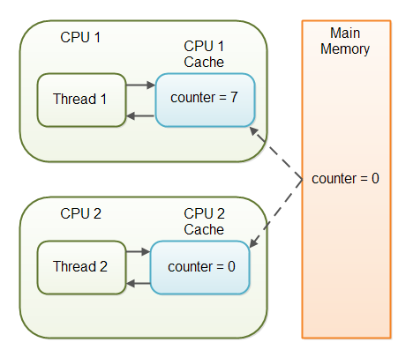
Volatile
With non-volatile variables there are no guarantees about when the Java Virtual Machine (JVM) reads data from main memory into CPU caches, or writes data from CPU caches to main memory. This can cause several problems .
public class SharedObject {
public int counter = 0;
}

Slide 64
Volatile Visibility Guarantee
The Java volatile keyword is intended to address variable visibility problems.
By declaring the counter variable volatile all writes to the counter variable will be written back to main memory immediately.
Also, all reads of the counter variable will be read directly from main memory.
Declaring a variable volatile thus guarantees the visibility for other threads of writes to that variable.
public class SharedObject {
public volatile int counter = 0; }

Slide 65
END

